Slide 1
Low-Energy Adaptive Clustering Hierarchy An Energy-Efficient Communication Protocol for Wireless Micro-sensor Networks M. Aslam hayat

Slide 2
Overview
Introduction
Radio Model
Existing Protocols
Direct Transmission
Minimum Transmission Energy
Static Clustering
LEACH
Performance Comparison
Conclusions

Slide 3
Introduction
LEACH (Low-Energy Adaptive Clustering Hierarchy) is a routing protocol for wireless sensor networks in which:
The base station (sink) is fixed
Sensor nodes are homogenous
LEACH conserves energy through:
Aggregation
Adaptive Clustering

Slide 4
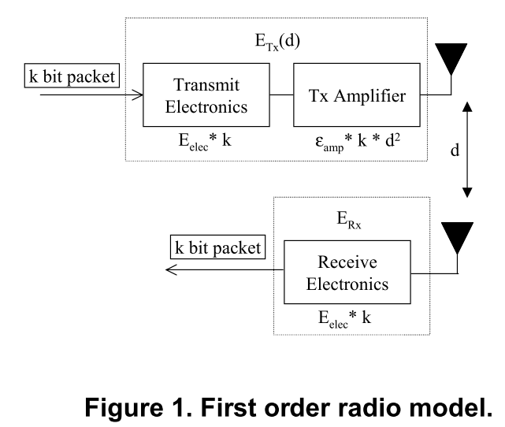
Radio Model

Slide 5
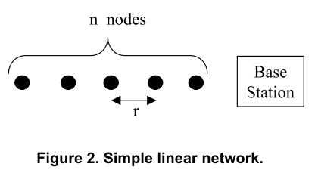
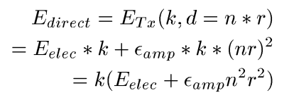
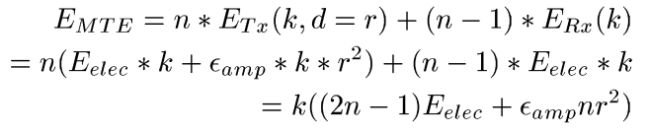
Energy Analysis

Slide 6
LEACH
In LEACH, the nodes organize themselves into local clusters, with one node acting as the local base station or cluster-head.
These cluster-head nodes broadcast their status to the other sensors in the network.
Each sensor node determines to which cluster it wants to belong by choosing the cluster-head that requires the minimum communication energy.
the cluster-head nodes are not ﬁxed.
The decision to become a cluster-head depends on the amount of energy left at the node.

Slide 7
LEACH Algorithm
Advertisement Phase
Cluster Phase
Schedule Creation
Data Transmission
Hierarchical Clustering

Slide 8
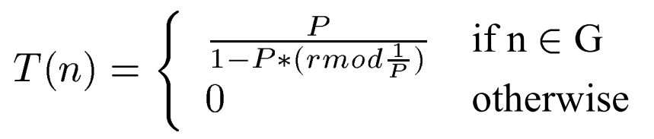
Advertisement Phase
For this “cluster-head-advertisement” phase, the cluster-heads use a CSMA MAC protocol, and all cluster-heads transmit their advertisement using the same transmit energy.
decideClusterHead {} in ns-leach.tcl

Slide 9
Cluster Phase
After each node has decided to which cluster it belongs,it must inform the cluster-head node that it will be a member of the cluster.
findBestCluster{} and informClusterHead{}
Each node transmits this information back to the cluster-head again using a CSMA MAC protocol.
During this phase, all cluster-head nodes must keep their receivers on.

Slide 10
Schedule Creation
The cluster-head node receives all the messages for nodes that would like to be included in the cluster.
Based on the number of nodes in the cluster, the cluster-head node creates a TDMA schedule telling each node when it can transmit.
createSchedule{}

Slide 11
Data Transmission
Non-cluster-head send data during their allocated transmission time to the cluster-head.
The radio of each non-cluster-head node can be turned off until the node's allocated transmission time, thus minimizing energy dissipation in these nodes.
When all the data has been received, the cluster head node performs signal processing functions to compress the data into a single signal.
This composite signal is sent to the base station.

Slide 12
Hierarchical Clustering
the cluster-head nodes would communicate with “super-cluster-head” nodes and so on until the top layer of the hierarchy, at which point the data would be sent to the base station.

Slide 13
Radio Model
Designed around acceptable E_{b}/N₀
E_{elec} = 50nJ/bit
Energy dissipation for transmit and receive
ε_{amp} = 100pJ/bit/m²
Energy dissipation for transmit amplifier
k = Packet size
d = Distance

Slide 14
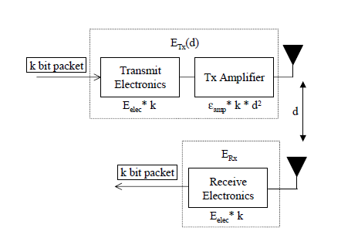
Radio Model

Slide 15
Existing Routing Protocols
LEACH is compared against three other routing protocols:
Direct-Transmission
Single-hop
Minimum-Transmission Energy
Multi-hop
Static Clustering
Multi-hop

Slide 16
Direct-Transmission
Each sensor node transmits directly to the sink, regardless of distance
Most efficient when there is a small coverage area and/or high receive cost

Slide 17
Minimum Transmission Energy (MTE)
Traffic is routed through intermediate nodes
Node chosen by transmit amplifier cost
Receive cost often ignored
Most efficient when the average transmission distance is large and E_{elec} is low

Slide 18
Energy Analysis of DT and MTE
direct communication energy equations
MTE communication energy equation
Simple linear network model

Slide 19
Energy Analysis of DT and MTE
Simulation on mat lab using energy equation
100-node random network
2000 bit packets
ε_{amp} = 100pJ/bit/m2
High radio operation costs favor direct-transmission
Low transmit amplifier costs (i.e. distance to the sink) favor direct transmission
Small inter-node distances favor MTE

Slide 20
LEACH: Operation
Periodic process
Three phases per round:
Advertisement
Election and membership
Setup
Schedule creation
Steady-State
Data transmission

Slide 21
LEACH: Advertisement
Cluster head self-election
Status advertised to nearby nodes
Non-cluster heads must listen to the medium
Choose membership based on signal strength
RSSI
E_{b}/N₀

Slide 22
LEACH: Setup
Nodes broadcast membership status
CSMA-CA
Cluster heads must listen to the medium
TDMA schedule created
Dynamic number of time slots

Slide 23
LEACH: Data Transmission
Nodes sleep until its time slots
Cluster heads must listen to each slot
Cluster heads aggregate/compress and transmit to Sink
Phase continues until the end of the round

Slide 24
Low-Energy Adaptive Clustering Hierarchy (LEACH)
Adaptive Clustering
Distributed
Randomized Rotation
Biased to balance energy loss
Heads perform compression
Also aggregation
In-cluster TDMA

Slide 25
LEACH: Adaptive Clustering
Periodic independent self-election
Probabilistic
CSMA CA used to advertise
Nodes select advertisement
with strongest signal strength
Dynamic TDMA time slots

Slide 26
LEACH: Adaptive Clustering
Number of clusters determined
Compression cost of 5nj/bit/2000-bit message
“Factor of 7 reduction in energy dissipation”
Assumes compression is cheap relative to transmission
Overhead costs ignored

Slide 27
LEACH: Randomized Rotation
Cluster heads elected every round
Recent cluster heads disqualified
Optimal number not guaranteed
Residual energy considered
P= Desired cluster head
percentage
r = Current Round
G = Set of nodes which have not
been cluster heads in 1/P
rounds

Slide 28
LEACH: Hierarchical Clustering
Not currently implemented
Efficient when network diameters are large

Slide 29
Conclusions
LEACH is completely distributed
No centralized control system
LEACH can reduce communication costs by up to 8x
LEACH keeps the first node alive for up to 8x longer and the last node by up to 3x longer

